Slide 1
Covid Vaccine Facilitator
Team Members:
Sailaja Pattadari
Ramya Reddy Guda
Sahithya Edla
Rakesh Dasapathri
Value Propositions:
Easy access to get vaccinated
Target Market:
Medical vaccination centers

Slide 2
Target Market and Value Proposition
Cooking Frenzy is a latest project which launched recently on Google app store. Company Spent 1.2 years on this project.
The game is under Beta testing.
All the public, as well as vaccination clinics, are the crucial targets.
Vaccination becomes necessary, but there is no application for it.
It enables all users to keep track of their Covid immunization records.
It allows the user to get to the vaccination centers quickly and easily.
It also keeps track of all vaccination centre information to avoid any problems
This application will be used by the user to perform vaccinations and other tasks.

Slide 3
Key Winning Features
Our system holds two main modules:
User or Patient Portal
Admin Portal
User module provides two basic features:
AI Chatbot Registration Module
Query Portal
Admin module provides two basic features:
Report Generator
Admin controls

Slide 4
User Module
AI Chatbot Registration
Cooking Frenzy is a latest project which launched recently on Google app store. Company Spent 1.2 years on this project.
The game is under Beta testing.
AI Chatbot will ask the necessary information about the user.
Save the information and reserve the appointment accordingly.
Reservation information will be used for the report generation.
Query Portal
User can contact admin using this portal.
This will facilitate the user for other basic functionalities.

Slide 5
Admin Module
Report Generator
Reservation's data will be used for report generation having all necessary information.
Report will be used for SOP’s related decisions.
It will show result in graphical manner.
Admin Control
Admin can resolve the queries requested by the user or patients.
Admin have access to see the reservations.
Admin have other main basic controls.

Slide 6
AI Chatbot features:
A chatbot will be implemented having AI support
Chatbot is responsible for all reservations
AI based chatbot consider all factors including limits and age factor etc.
All data will be generated in the backend according to chatbot.
Generated data will be used to generate a brief report

Slide 7
Capabilities and Justifications of solution
Recently, vaccines are in great need.
It is very difficult to book a vaccination at the Vaccination Center.
It is also difficult for the vaccination center to care for the entire population at the same time.
This application allows anyone to reserve their seat accordingly.
People can easily book a particular vaccine for booking.
The Vaccination Center also has data to display all bookings.
This application helps prevent confusion in the vaccination center.
The reports generated by the application help you make decisions about further blocks or implementations of the SOP.
Cooking Frenzy is a latest project which launched recently on Google app store. Company Spent 1.2 years on this project.
The game is under Beta testing.

Slide 8
Plan for implementation phase
User Portal
Target implementation Date: Oct 16th, 2021
AI chatbot
Target implementation Date: Oct 30th, 2021
Built user side functionalities in Java using Android Studio.
Added AI chatbot functionality in Python using Jupyter Notebook.
Admin Portal
Target implementation Date: November 13th, 2021
Testing
Target Date: November 27th, 2021
Should build admin portal and report generator functionalities in java.
Should test the complete functionality of application.
Final review
Target Date: December 3rd, 2021
Submit the final deliverable after complete end-to-end testing

Slide 9
Use Cases For the System
AI Chatbot
Query Portal
Settings
Update Information
Report a problem
Maintain health report
Admin Portal
See queries
Reservations
Settings
Update Information
Report Generator

Slide 10
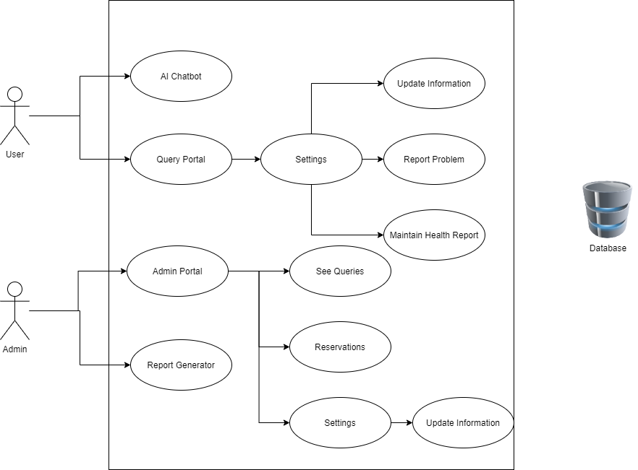

Slide 11
Conclusion
Patients and users will easily find the vaccination centres.
To avoid the rush situation, application have limited number reservations for the people who want vaccination.
Some departments need numbers of vaccination per day.
The report generated by the system will hep them to take required actions.
AI Chatbot facilitates the user for easy reservations.

Slide 12
Thank You

